Slide 1

Women Drivers
Presenter : Ms. Magadi Gainewe

Slide 2
Table of content
Human Population
Vehicles population
Vehicles ownership
Drivers licence issued
Road Traffic Information

Slide 3
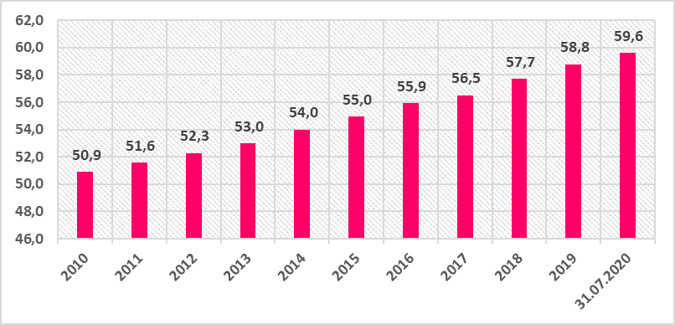
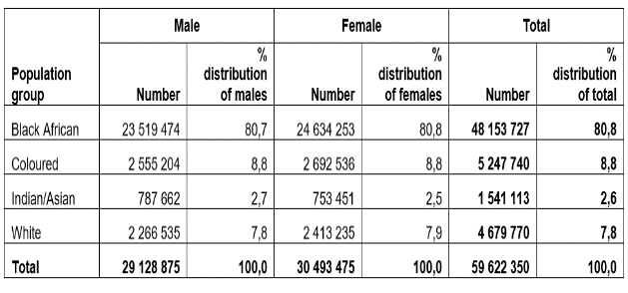
Human Population
49%
51%
Mid-year population estimates , Statistics South Africa
Life expectancy: 63 yrs
Life expectancy: 69 yrs

Slide 4
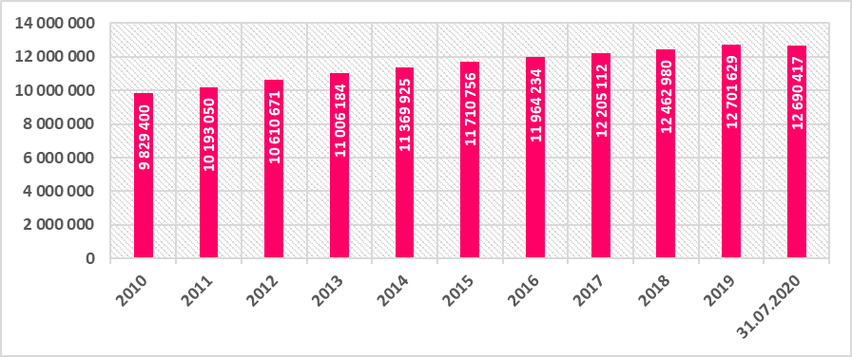
Number of Registered vehicles

Slide 5

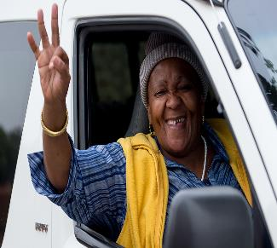

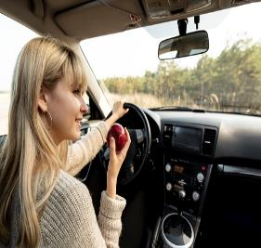
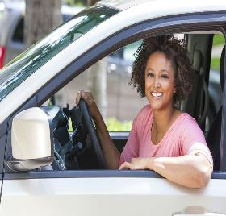

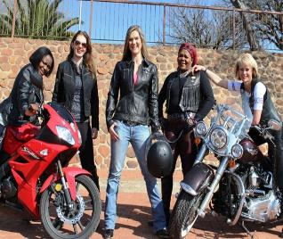

Slide 6
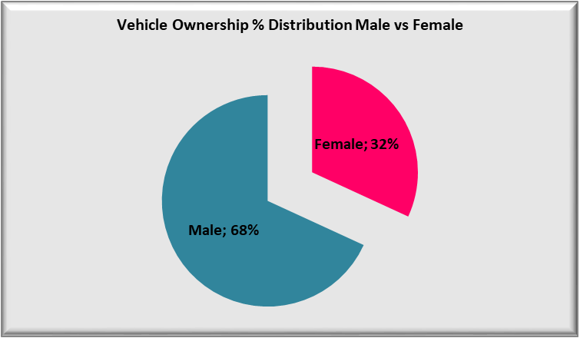
Vehicle ownership per gender

Slide 7
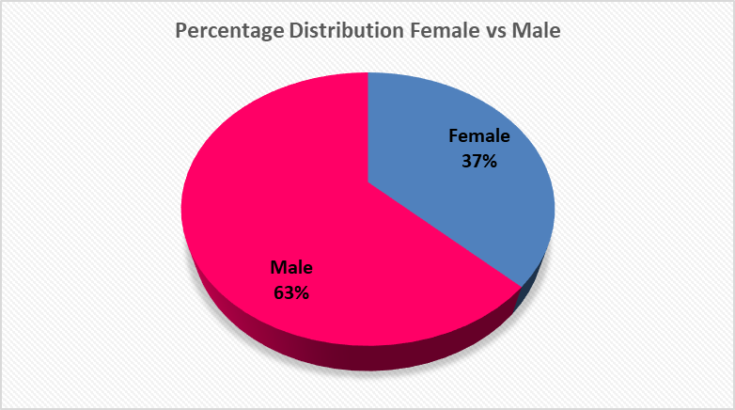
Number Drivers Licence issued as on the 18.8.2020

Slide 8
Road Traffic Information

Slide 9
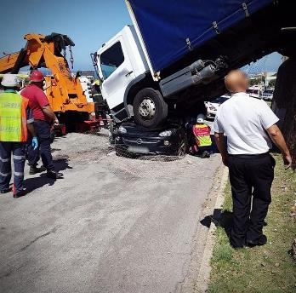
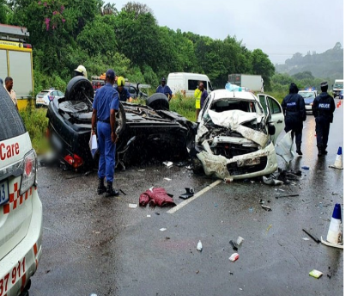
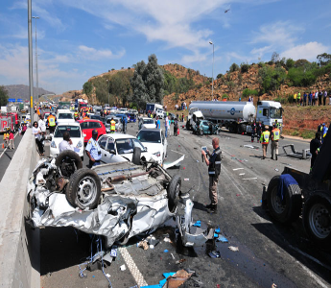

Slide 10
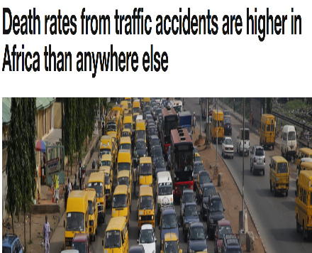
Global view
Worldwide, male drivers have a higher risk of dying in a car accident than women due to their inclination to speed more, drink more and take more risks
Deaths from road accidents are at least twice as high in South Africa as the global average.
The most dangerous drivers are young men.
While women are statistically safer on the road, they have just as many accidents as men; however, they tend to be minor fender-benders, while men are usually involved in more serious collisions.
Cautious old ladies are more inclined to die behind the wheel than speeding teenage boys – not because they’re reckless, but because they’re frail and less likely to survive injury.
In the UK and the US, the drivers of station wagons have a death rate of less than half the national average for cars due to the fact that they’re safer on the roads and their drivers tend not to take risks.

Slide 11
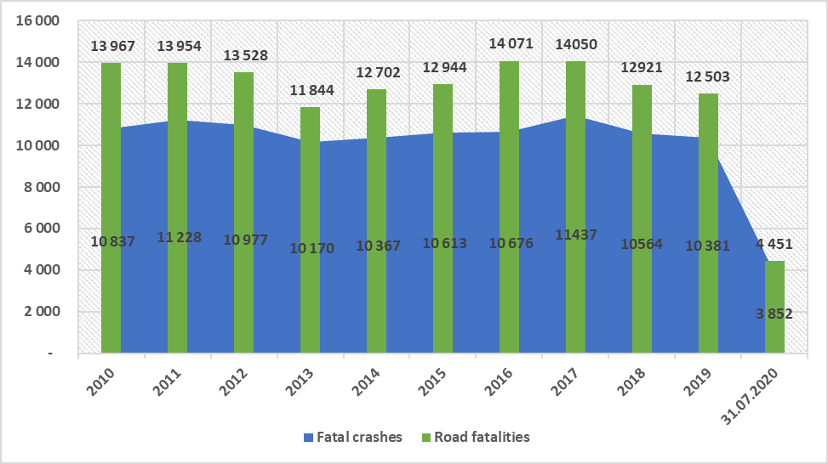
Number of fatal crashes and fatalities in South Africa

Slide 12
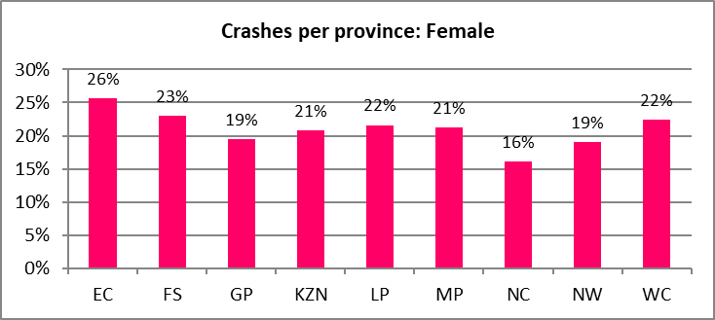
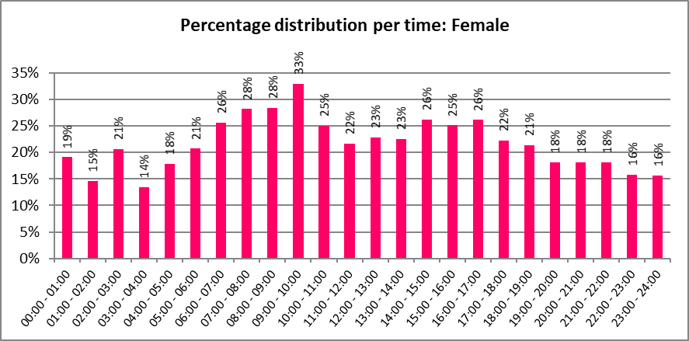
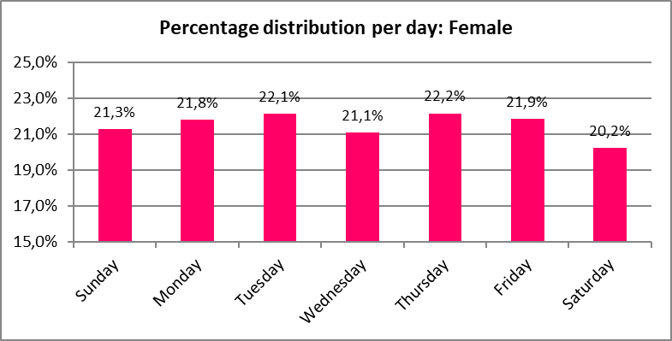
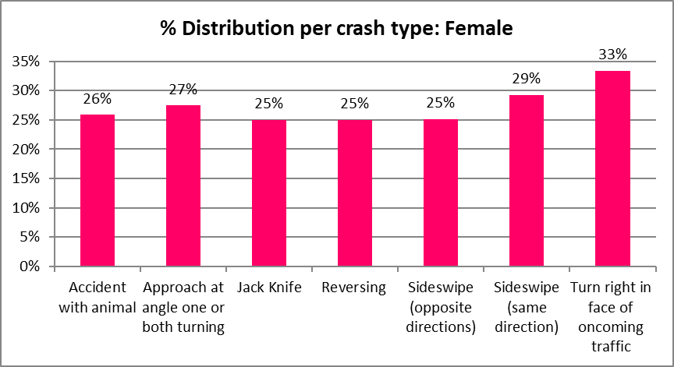
2019 Information for females only

Slide 13
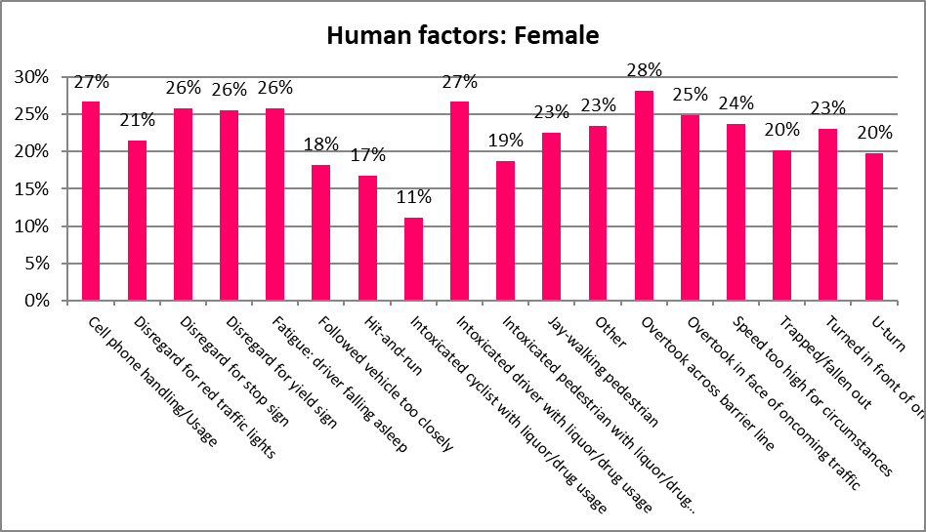
Percentage distribution of contributory factors
Contributory factors:
Contribute 24% on average for all the three
The highest being the vehicle factor

Slide 14
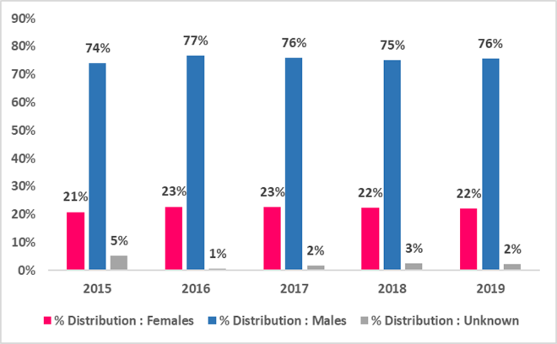
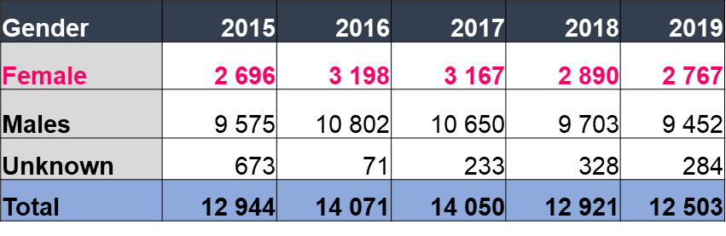
Fatalities for females: 2015 - 2019
Average: Female
2 944

Slide 15
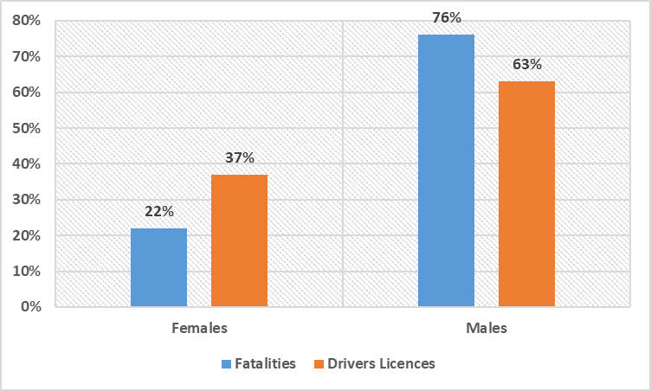
Percentage distribution of Fatalities vs Drivers Licences per gender

Slide 16
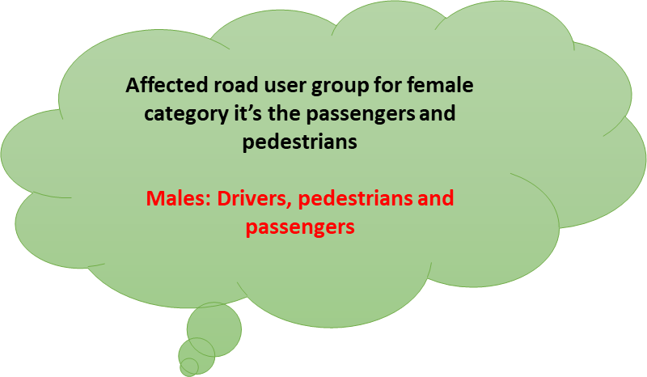
Percentage distribution of fatalities per road users
Most provinces contributed 20% on average

Slide 17

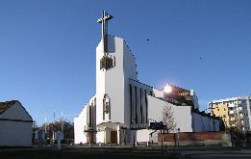



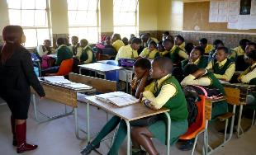


Impact of COVID - 19

Slide 18



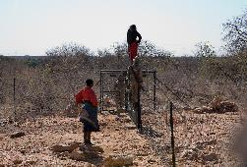
Cont…

Slide 19
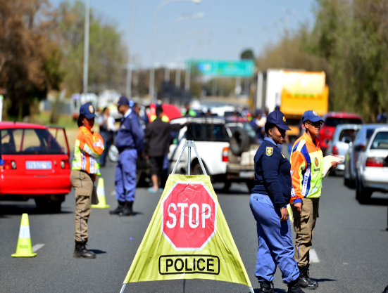
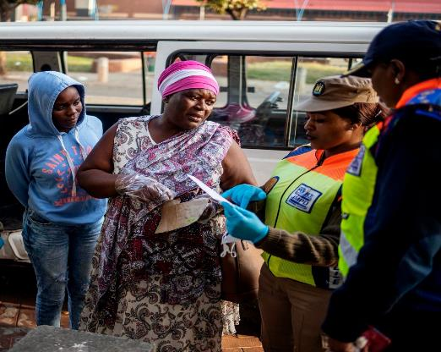
Impact of COVID - 19

Slide 20
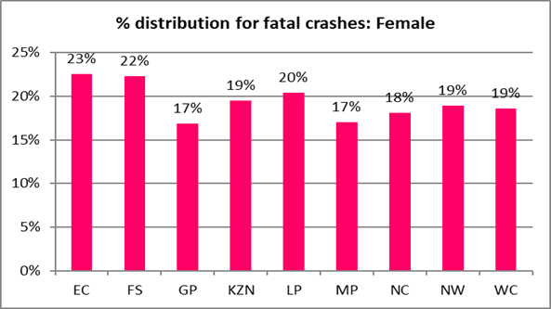
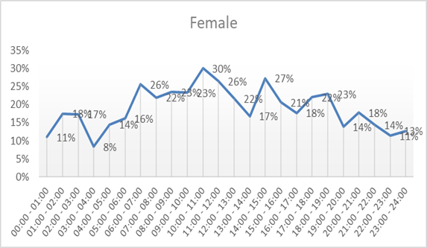
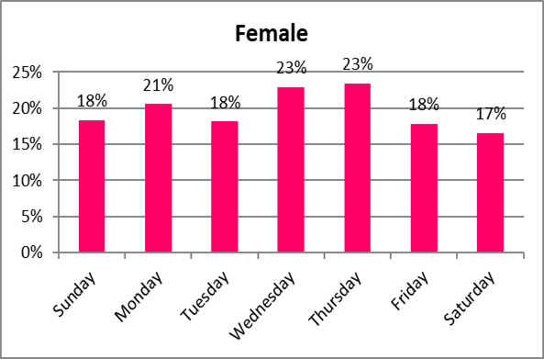
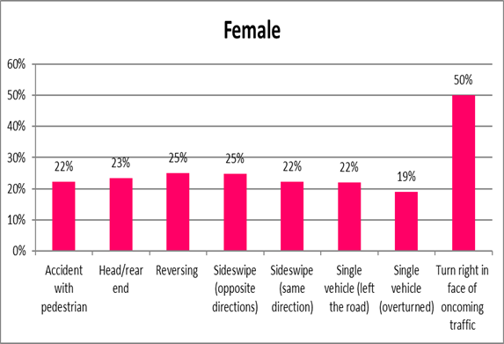
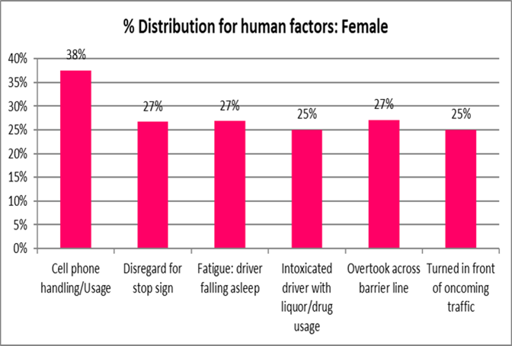
Females fatal crashes and fatalities as from Jan – July 2020
+800 fatal crashes: Females
Contribution of 20%

Slide 21
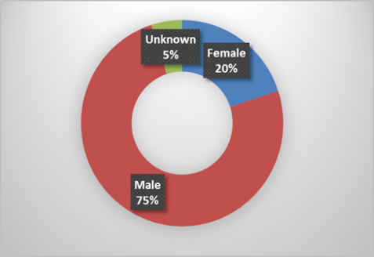
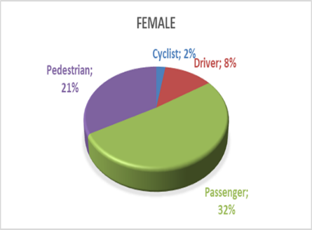
Percentage distribution of fatalities per gender and road user

Slide 22
Consequences of road crashes
Unnecessary trauma to members of the family,
Economic and Financial loss to family and the nation,
Social resources are stretched to accommodate unnecessary “emergencies”,
Many young people die untimely due to road crashes,
Young people are left with long-term injuries or disabilities.
The extent of disability can range from minor or short-term incapacity which may affect day-to-day living or activities to severe or permanent disabilities.

Slide 23
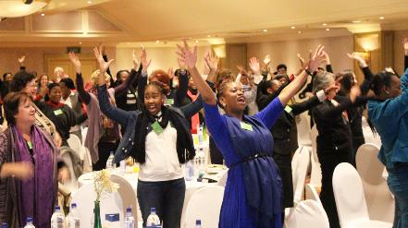
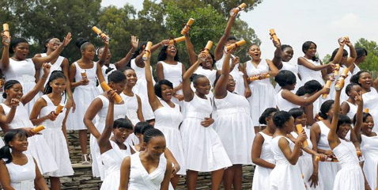

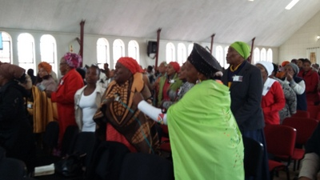

Slide 24
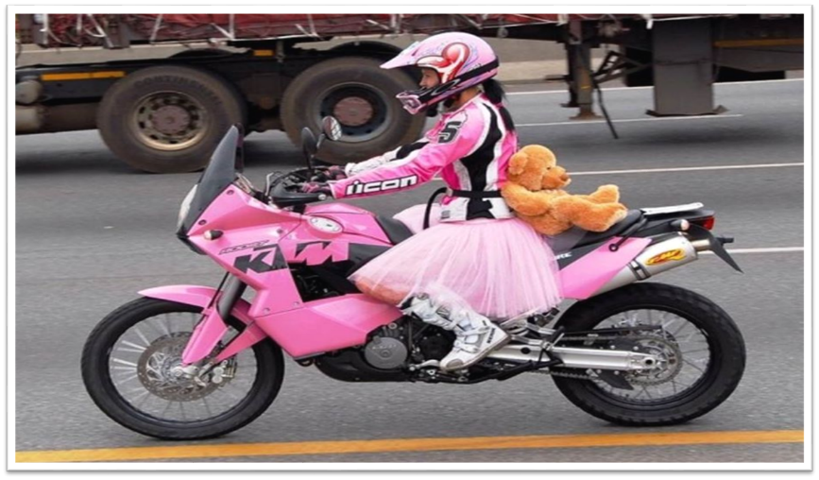

Slide 25
THANK YOU!

